Slide 1
ITSF 2021
Adam Paterson | Head of Product Management
‘Making it Work’
Synchronization Testing Across Industries

Slide 2
Making it Work…
Multiple applications are now truly using real-world network synchronization
This means timing issues can be the blocker to deployment
Standards help, but…
There are always some specifics that must be dealt with in practice
Even within ‘Telecoms’ many traditionally different industries/groups increasingly required to work together, the impact can be surprising!
Photo by Randy Fath on Unsplash

Slide 3
Making it Work… A common theme
2 examples today based on recent engagements in:
Open RAN
5G Backhaul
A common theme to highlight: uncovering assumptions….
Photos by Ben Griffiths, Kirill Gusev, Dollar Gill on Unsplash

Slide 4
ORAN
Perceived benefits are well publicised!
Key challenges:
Standards, performance and knowledge
Isn’t that always the case?!
Also, there are standards! There are testing events!
*Calnex survey of 100+ vendors and operators investigating Open RAN technologies

Slide 5
ORAN complexity – the ‘hidden rules’
Several Challenges:
Distributed information across WGs
Information cannot be 100% comprehensive
Not all assumptions in specifications are explicit - this leaves knowledge gaps
Photo by Jeremy Bezanger on Unsplash
Notes:
Say thanks 🙌
Give a shoutout to Jeremy Bezanger on social or copy the text below to attribute.

Slide 6
A practical example: Open Radio Units (O-RUs)
Prime candidate for introducing new vendors to improve competition:
Cost, Power savings, etc….
Also a prime target to aim for performance parity
ORAN Specifications derived logically from e.g. 3GPP and ITU-T
Max|TE| = 80ns (regular O-RU) or 35ns (enhanced O-RU)
(Table 9-3)
Max|TE| = 60ns (regular O-RU)
or 15ns (enhanced O-RU)
(Table 9-3, following IEEE802.1CM)
Max|TE| = 20ns
(IEEE802.1CM,
but removed in IEEE802.1CMde)
O-RU
PTP/SyncE
input
T-TSC
RF multiplier
Antenna
1pps
(if available)

Slide 7
A practical example: Open Radio Units (O-RUs)
In a smaller ecosystem, all developers would naturally be aware of the filtering requirement this puts on the device:
“ [We] always understood […] to heavily filter the incoming TDM synchronization signal to make the radios work. This was an implicit understanding – it was never written down in the standards. This understanding remained when the backhaul switched from TDM to packet and IEEE1588 and SyncE arrived on the scene 10-15 years ago. “
New developers receive the end performance requirements, but not explicit detail on the filtering implied, determined several decades previous…

Slide 8
Why does this matter?
Many benefits from ORAN are perceived to come from the introduction of new players
This allows ‘specialisation’
The standards must remain open if they will ever achieve interoperability goals
‘Unwritten rules’ pose problems for new entrants!
Note: this is not an ‘issue’ with the standards, rather a fact of life – but worth being aware of!

Slide 9
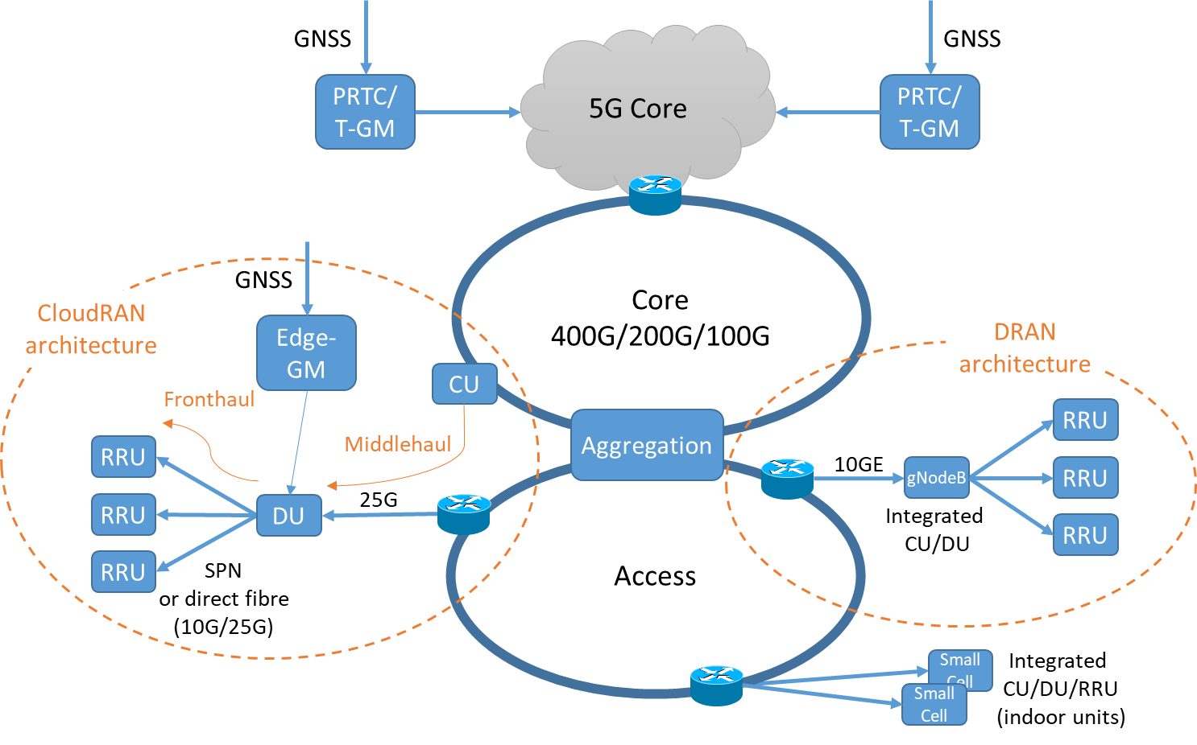
5G backhaul – Knowns and Unknowns?
Well understood that introducing new rates adds to development and test requirements
Common themes for time and sync: different lane speeds, encoding types, impact of latency for FEC implementations……
……What about optics???

Slide 10
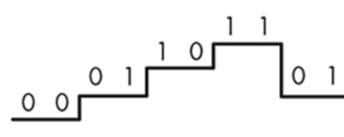
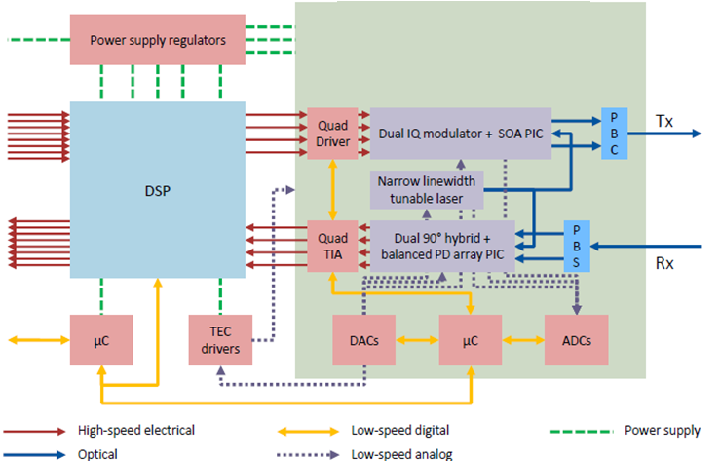
PAM4 and Digital Coherent Optics (DCO)
PAM4 Optical transmission
Benefits:
Main medium for introducing higher network rates
Downsides:
Complexity for host…
DCO transmission
Benefits:
Higher network rates, long reach, flexibility/programmability
Complexity is in the modules rather than the host
Downsides:
Power/Thermal
Complexity is in the modules rather than the host!

Slide 11
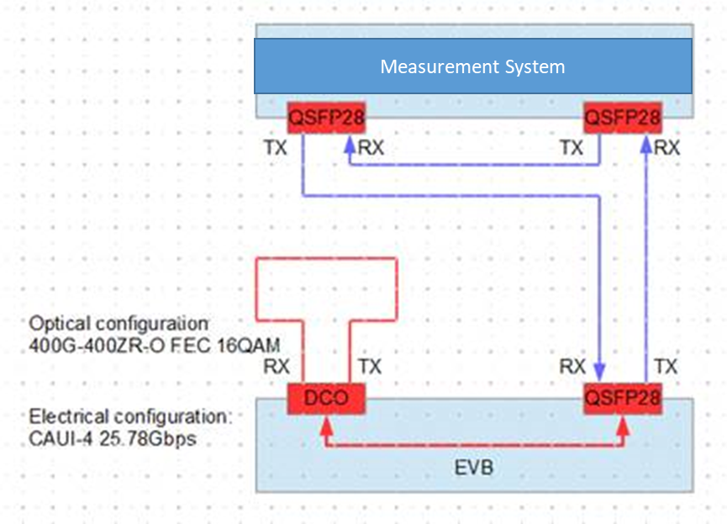
Investigations: Impact of Optics on ‘complete’ device timing performance
Preliminary testing using known performance ‘golden’ optics and eval board loopback
(note: worst case impact of NRZ optics on latency/timing measurements is in the picoseconds)
Detailed testing now in progress using specifically developed latency testing methodology

Slide 12
Preliminary results – timing impact of PAM4 optics
Time Error
Max|TE|
dTE
cTE
0
Time
 | 50G PAM4 (SR) | 400G PAM4 (LR8) | 400G PAM4 (FR8) | 400G PAM4 (FR4)
Typical Latency (ns) | 67.81 | 65.25 | 64.67 | 73.77
Run to run Latency variation (ns) | +/-0.01 | +/-0.01 | +/-0.01 | +/-0.01
PAM4 optics introduce an additional challenge when using with devices targeting ITU-T Class-C or Class-D specifications
For Class-D, optics become a significant contributing factor to ‘device’ performance:
Unmatched optics on a link could affect cTE in the range of ≈5ns

Slide 13
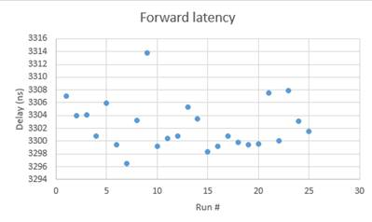
Preliminary results – timing impact of DCO modules
 | 400G DCO
Typical Latency (ns) | 3302.45
Run-to-run Latency variation (ns) | +/-10
Run-to-run variation suggests DCO modules could be unsuitable for Class-D applications and extremely challenging for Class-C
The very high latency (compared to other module types) suggests strict planning and control would be required for any timing-sensitive deployment

Slide 14
Next Steps
More investigation – biggest delay/variation contributions?:
Specific chipsets
Rx Clock Recovery
Line coding, FEC…
Short term, very close management of deployment conditions required?:
Some vendors already investigating ‘matched optics’
Investigate improvements to ‘next-gen’ of optical modules:
Performance improvements
‘e1pps’ or other methods to compensate for run-to-run variation ‘on-the-fly’
In short, there is a lot of further discussion needed…

Slide 15
Summary and Conclusions
It is known and accepted that new technology iterations pose challenges when meeting sync performance requirements – the industry as a whole has good reason to believe these can be overcome!
Some of the current/upcoming challenges for synchronization may not be where we expect!
Talking and sharing experience will help get ahead of these issues
Some pending challenges are ready to act on now – we are interested to progress these discussions, e.g. optical module performance

